Slide 1
Montenegro
Wild Beauty
Christian Baumgartner

Slide 2
Learning Outcomes
After completing this case study learners should be able to demonstrate the following principles of sustainable tourism development:
the principle of participation of local and regional stakeholders to ensure the long-lasting success of the development;
the principle of local empowerment, especially in comparison with foreign investment; and
the principle of systemic project management and step-by-step implementation plans.

Slide 3
Background
10-year development project in the region of the national park: Biogradska Gora
Five municipalities of the region fostered active outdoor tourism, hiking, rafting, mountain biking
Linkages with cultural assets of the region and creation of synergies with other economic sectors to create regional benefit
Development based on trust building, cooperation between five communities and the national park and integration of regional stakeholders

Slide 4
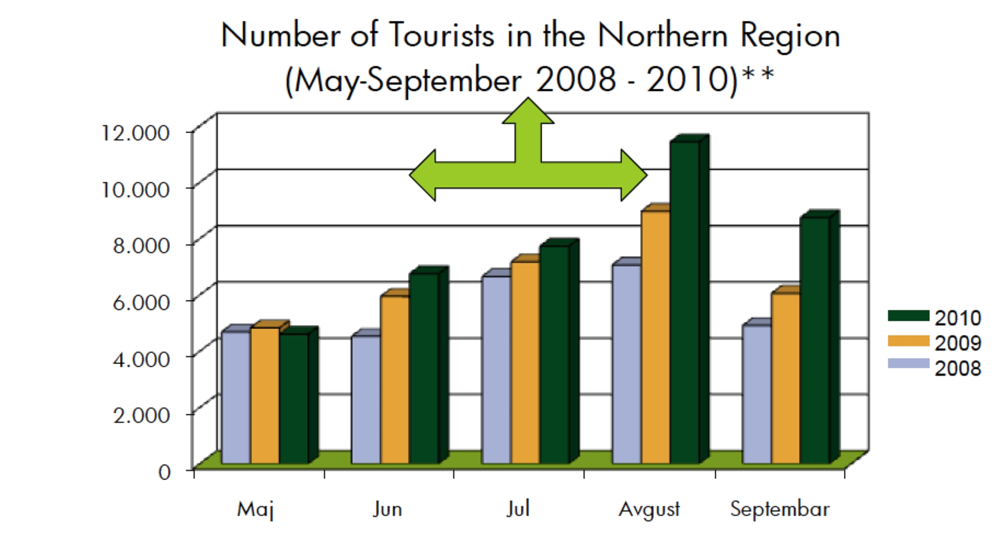
Tourist Numbers

Slide 5
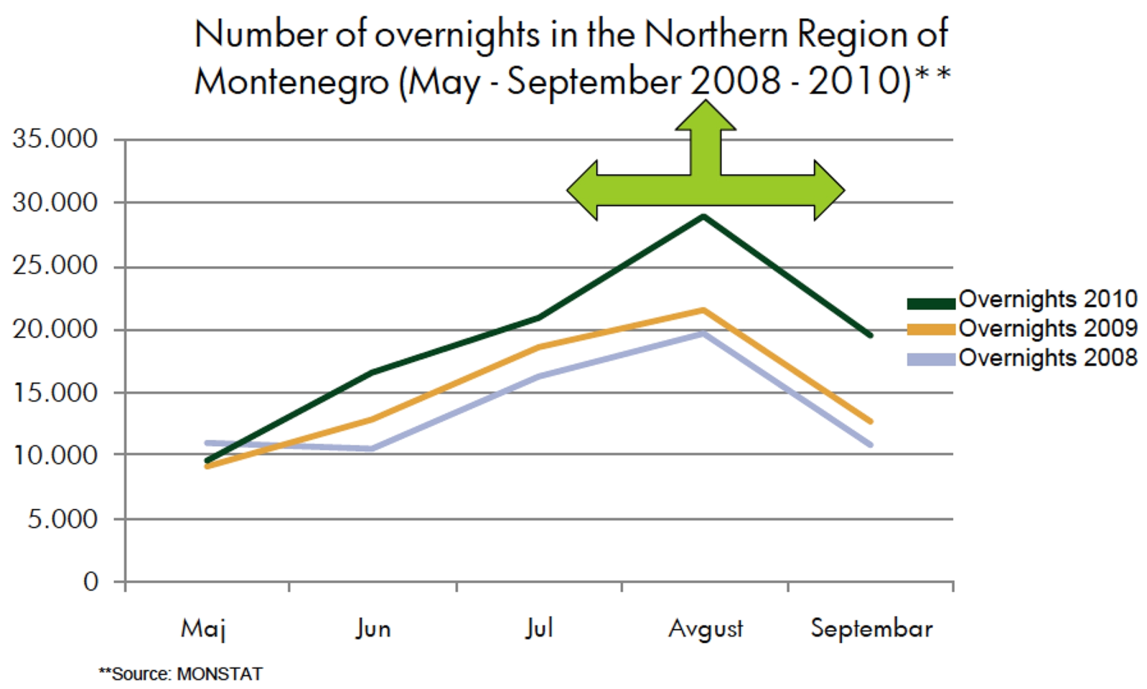
Overnights

Slide 6
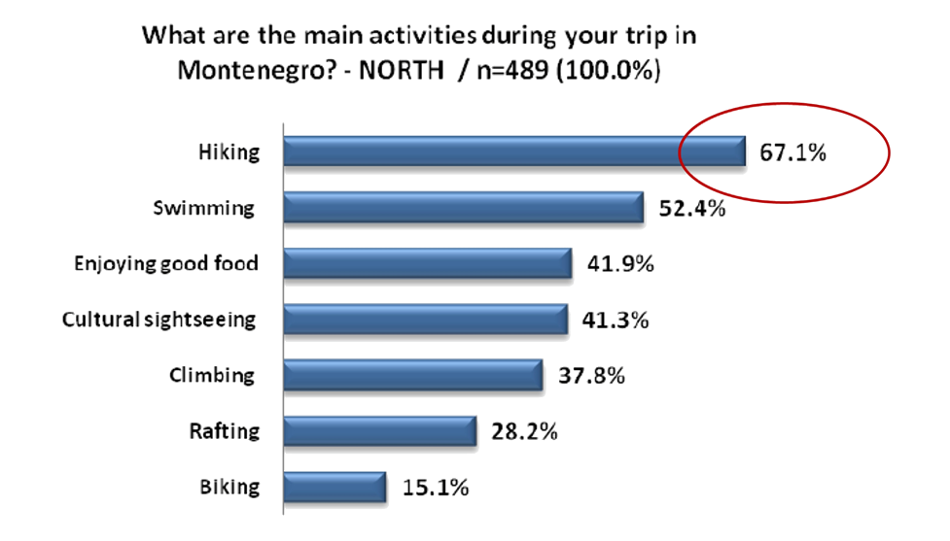
Activities

Slide 7
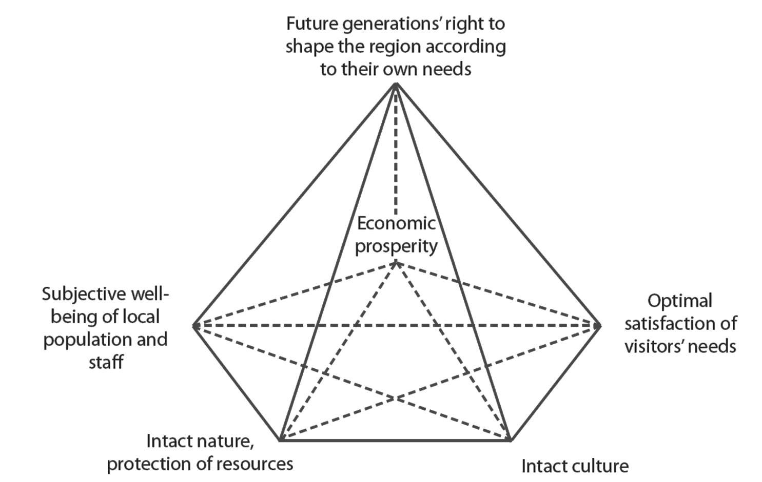
Sustainable Development Pyramid

Slide 8
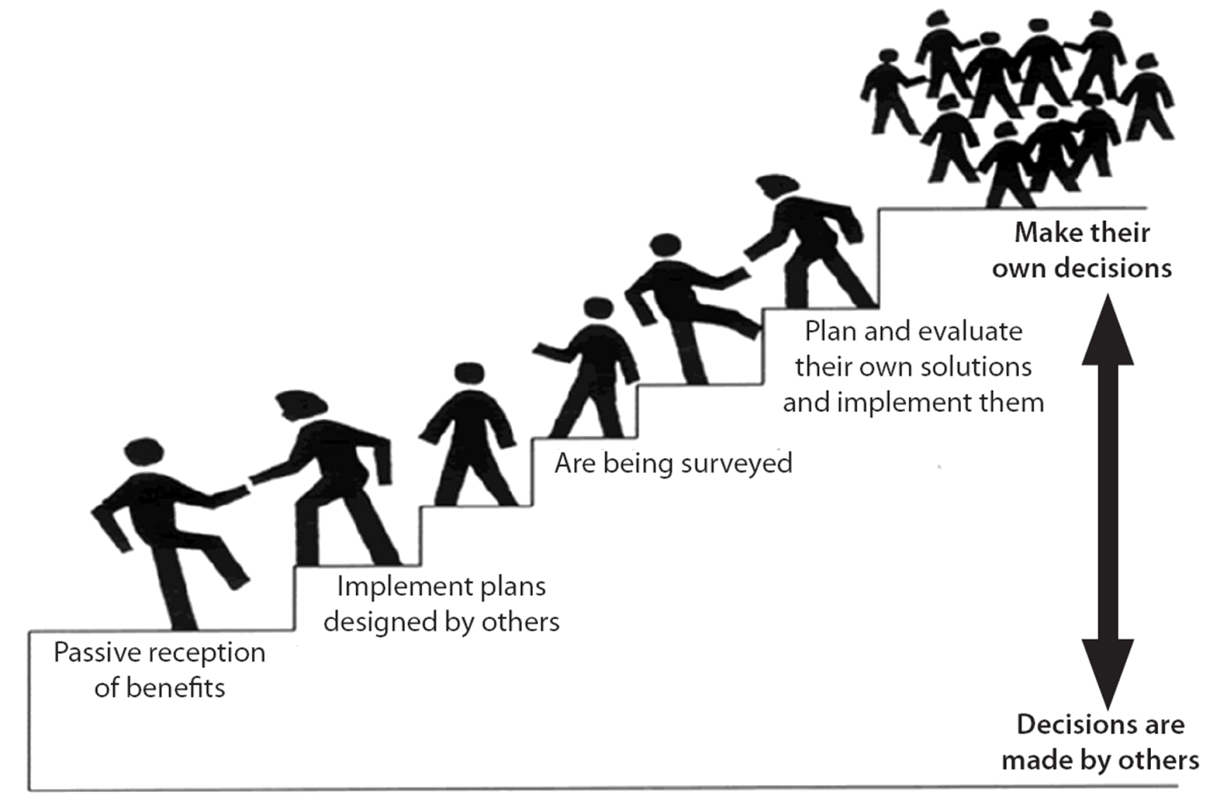
Participation Stages

Slide 9
Participation
Different methods in different stages of the project
SWOT analysis of the region
Memorandum of Understanding (MoU), signed by all five mayors, ministers, the director of the national park and NGO representatives
Foundation of Regional Tourism Organisation (RTO).

Slide 10
Training and Professionalization
Training program for different stakeholders in both tourism hardware (e.g. accommodation and other infrastructure) and software (e.g. services and activities).
Cooperation with international experts, e.g.
Austrian Association of Alpine Organisations
German speaking tour operators
Low-energy mountain hut using ecological building construction

Slide 11
Linkages to Regional Development
Development of quality criteria and a regional brand
Starting with herbs, herbal teas and dried forest fruits sold in the new shop at the national park visitor centre
Up-grading program for tourism schools to improve curricula, train the teachers and invest in school equipment

Slide 12
Inclusion in National Frameworks
Supported on national level by
Masterplan for Sustainable Tourism Development
Strategic Framework for Development of Sustainable Tourism in Northern and Central Montenegro
Development of the brand ‘Wild Beauty’ creating a frame for all nature related activities
Tourism Development Strategy to 2020

Slide 13
Study Questions
What are the relevant principles for sustainable tourism development in this case?
How important is participation for long-term success?
Compare tourism development in the Montenegrin hinterland (this case) with the development of coastal tourism (in Montenegro or in general) in terms of sustainability.
In terms of sustainable regional development, discuss how an empowerment approach may be more sustainable than foreign investment.

